Slide 1


FIRE EXTINGUISHING ROBOT

Slide 2
01.
INTRODUCTION
CONTENTS
02.
APPLICATIONS
03.
UNIQUENESS
04.
PROJECT PLAN
CONTENT
05.
CAD MODEL
06.
CONCLUSION

Slide 3

INTRODUCTION
0
1
Fire is like a double-edged sword. It can take a terrible form and turn everything into ashes. Fire accidents are getting common these days. In the event of a fire breakout, to rescue people and to put out the fire we are forced to use human resources which are not safe. With the advancement of technology especially in robotics it is very much possible to replace humans with robots for fighting the fire. This would improve the efficiency of firefighters and would also prevent them from risking human lives.

Slide 4
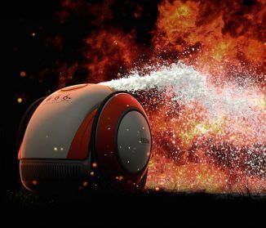
APPLICATIONS
0
2
The aim here is to build a fire extinguishing robot that can help in-case fire breaks out. Robotic firefighting systems are designed with the mindset of analyzing and locating fires, conducting search and rescue, monitoring hazardous variables and the primary task of fire control and suppression. Fixed firefighting robotic systems, like automatic fire sprinklers and alarms, are used in heavily populated and hazardous areas for rapidly extinguishing any threat.

Slide 5
UNIQUENESS
0
3
The advantage of this Robot is that it turns ON as it detects the fire around its surroundings, using the sensors used and tries to extinguish it by moving in the direction with respect to the fire with the help of the its water. Also it replace humans with robots for fighting the fire.

Slide 6
Project Plan
0
4
The main brain of this project is the Arduino.
When fire burns it emits a small amount of Infra-red light, therefore we use IR receiver to sense fire.
Then we use an Op-Amp to check for change in voltage across the IR Receiver, so that if a fire is detected the output pin (DO) will give 0V(LOW) and if the is no fire the output pin will be 5V(HIGH).
We use the motors to move near the fire by driving our motors through the L293D module.
When near a fire we have to put it out using water. Using a small container we can carry water, a 5V pump is also placed in the container and the whole container is placed on top of a servo motor so that we can control the direction in which the water has to be sprayed.

Slide 7
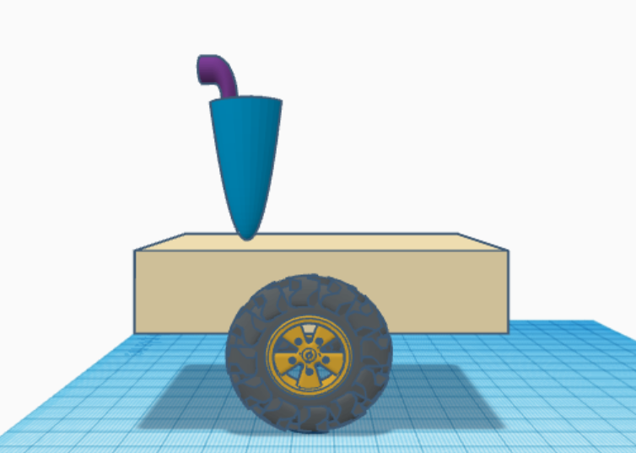
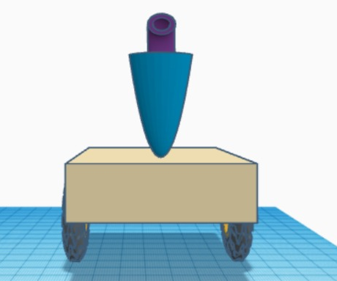
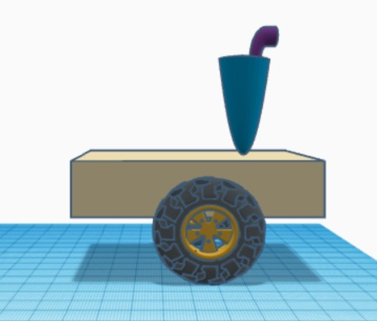
CAD MODEL
0
5

Slide 8
CONCLUSION
0
6
This fire extinguishing robot is a prototype of the actual one. This would improve the efficiency of firefighters and would also prevent them from risking human lives.

Slide 9
THANK YOU
Made by
Aditya Sharma 211116434
Bhumika Negi 211116461
Harshil Shukla 211116443
Rayan Rawat 211116456
Soumya Laharpure 211116417

